Slide 1
My big question, gap in knowledge, or assertion
My name - Institution
Supporting figure
Statement of motivation
Here is why I think we need to address my big question
Include no more information than you can present in 30-45 seconds. Slides will be auto-advanced during the workshop. Final timing will be announced prior to the workshop.
Proposal for resolution
Here is how I propose we resolve this question/gap/need

Slide 2
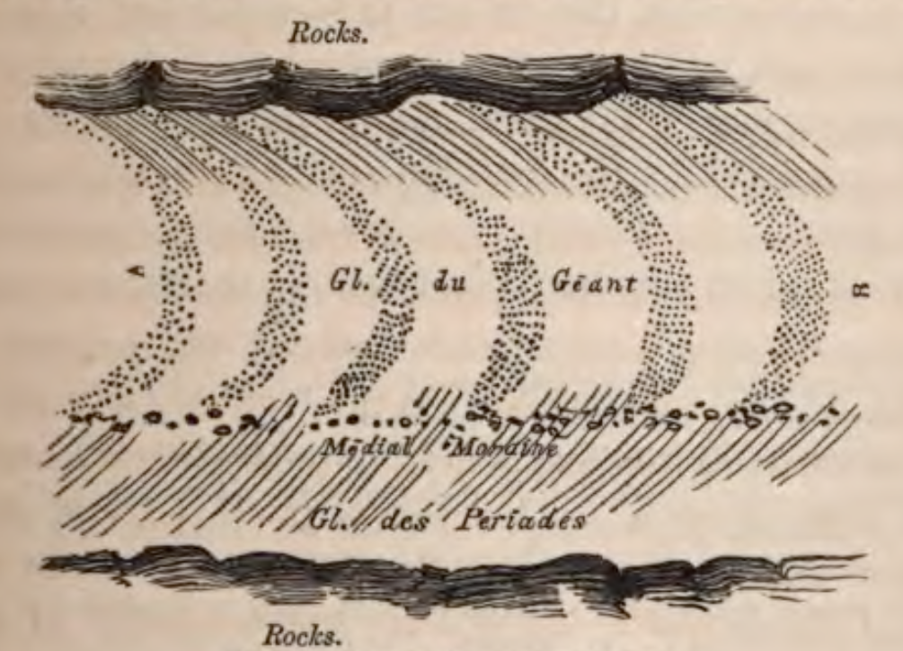
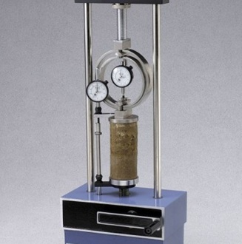
What is the relationship between stress and ice flow within the Greenland Ice Sheet?
John Glen - University of Cambridge
Statement of motivation
Projections of ice sheet change require a quantitative description of flow
We qualitatively understand viscous ice flow, but we lack a thorough understanding of the temperature-dependent relationship between deviatoric stress and strain rate
(Forbes, 1859)
Proposal for resolution
Lab experiments of polycrystalline ice under compression could meet this need
By controlling ice sample temperature, we can identify the rheological sensitivity to temperature
Measuring ice creep rate at several stresses can allow us to identify the extent to which flow is not Newtonian

